Slide 1
24MAT120
S2 P & M

Slide 2
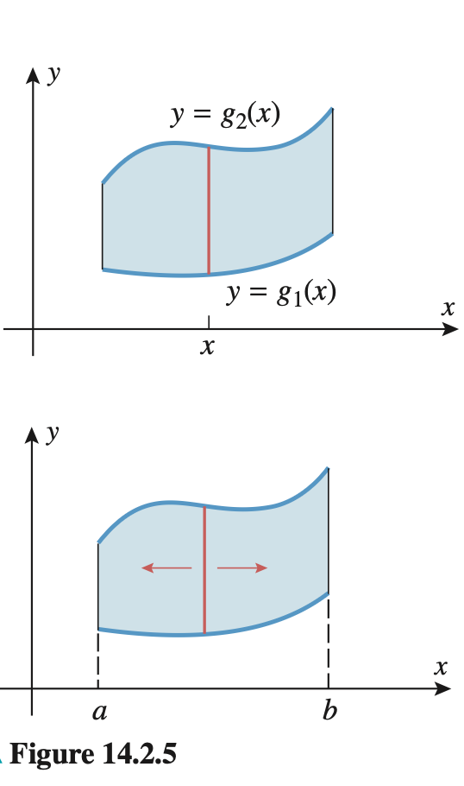
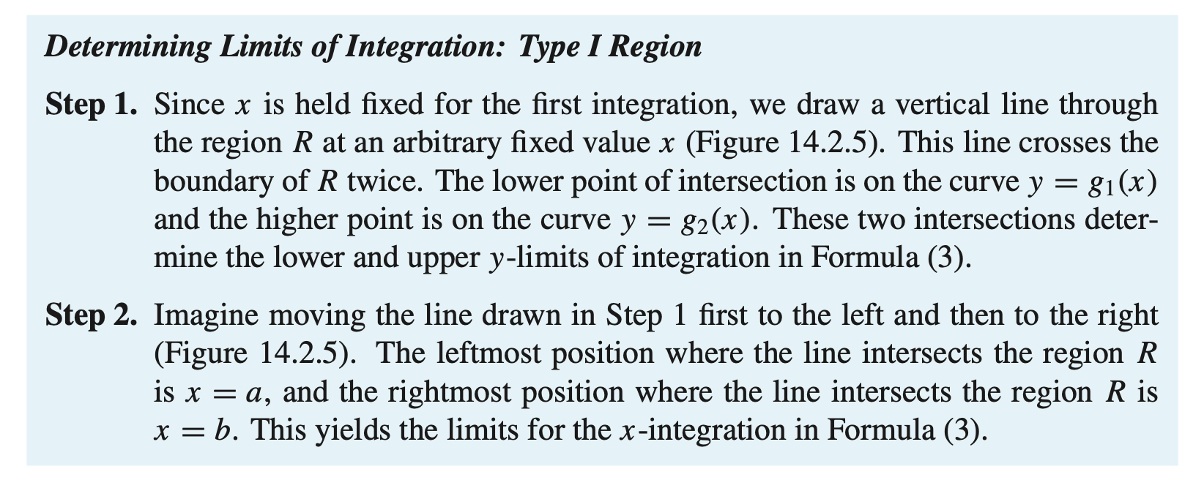

Slide 3


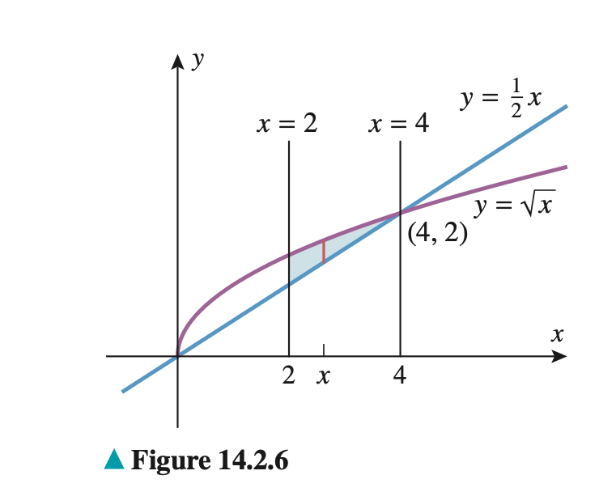
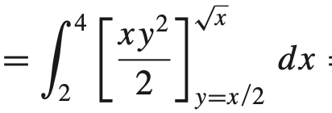



Slide 4

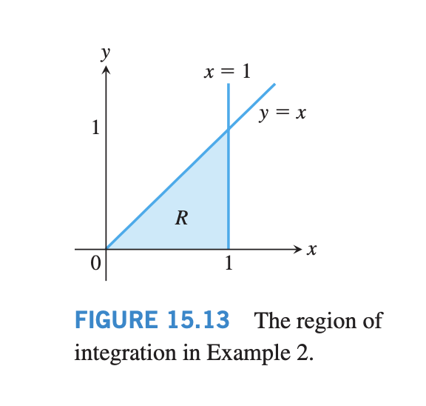


Slide 5
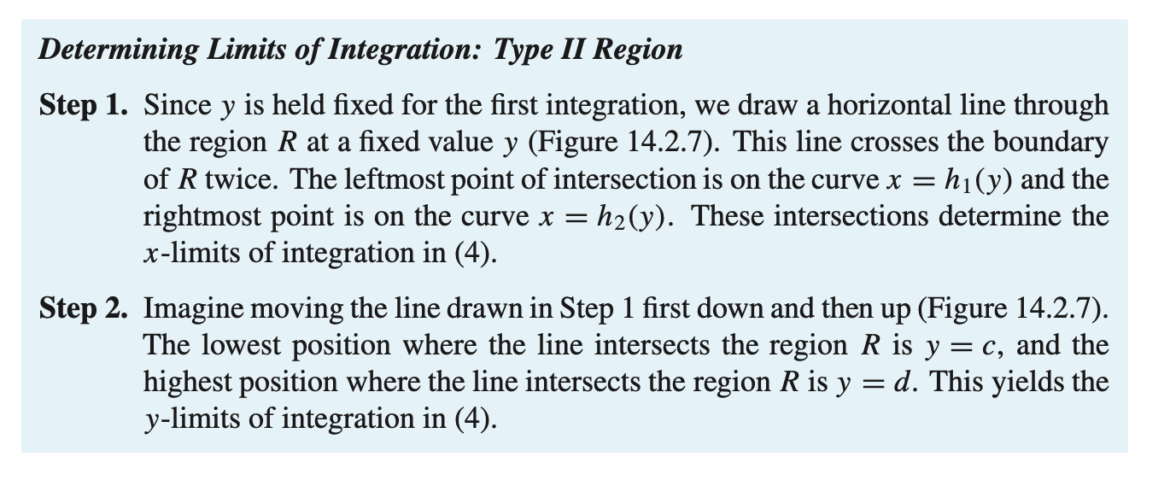
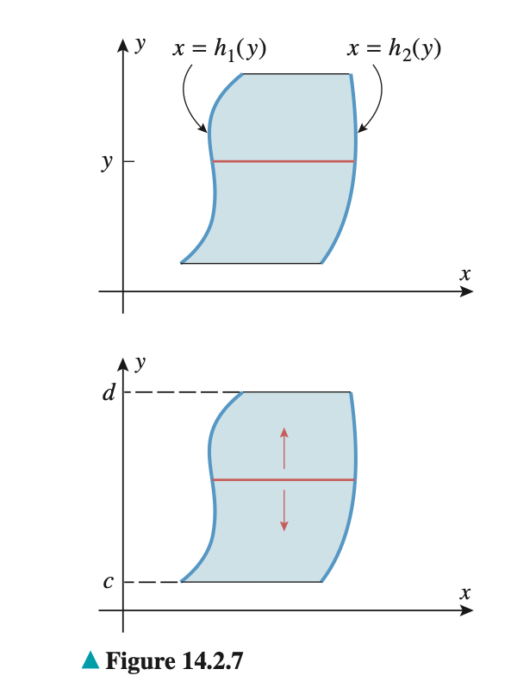

Slide 6


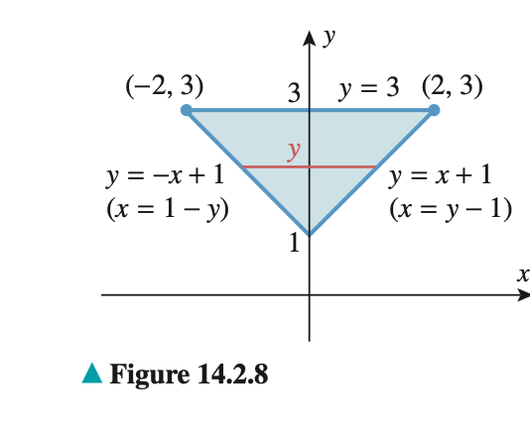




Slide 7
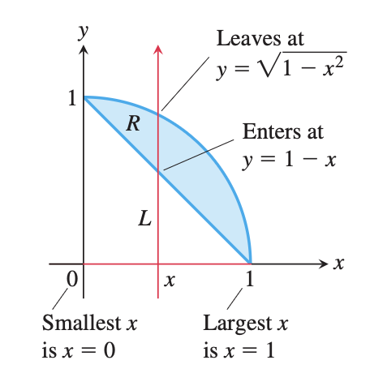
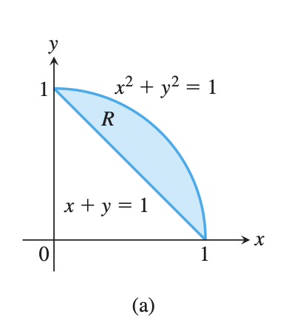
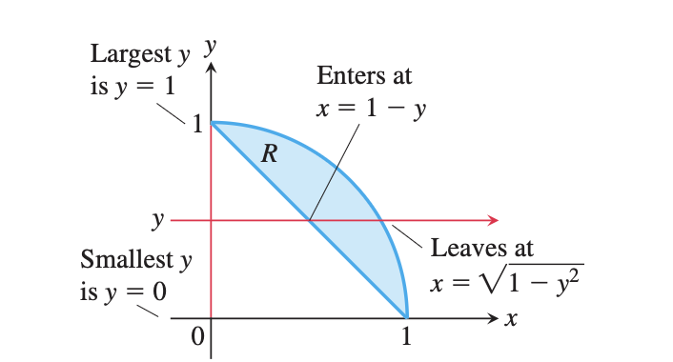
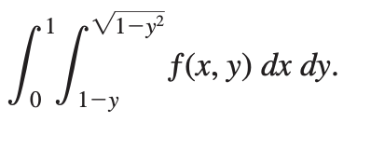
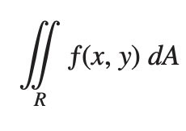


Slide 8


Slide 9
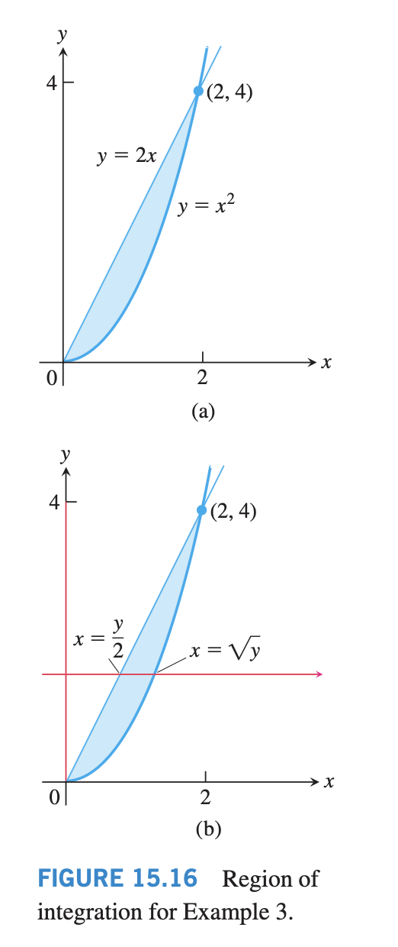

Slide 10
Assignment 2
There will be a total of 18 problems in the upcoming files.
The assignment must be handwritten (written only).
No copying will be tolerated under any circumstances.
Genuine excuses will be considered only if communicated well in advance.
The last date for submission is 22 April 2026, 5:00 PM.
This assignment will be accounted for Continuous Evaluation (CE).
AI tools may be used for reference, but direct copying is strictly prohibited.
If you do not submit, you will lose marks and attendance, and you will also miss out on learning double integration.

Slide 11


Slide 12
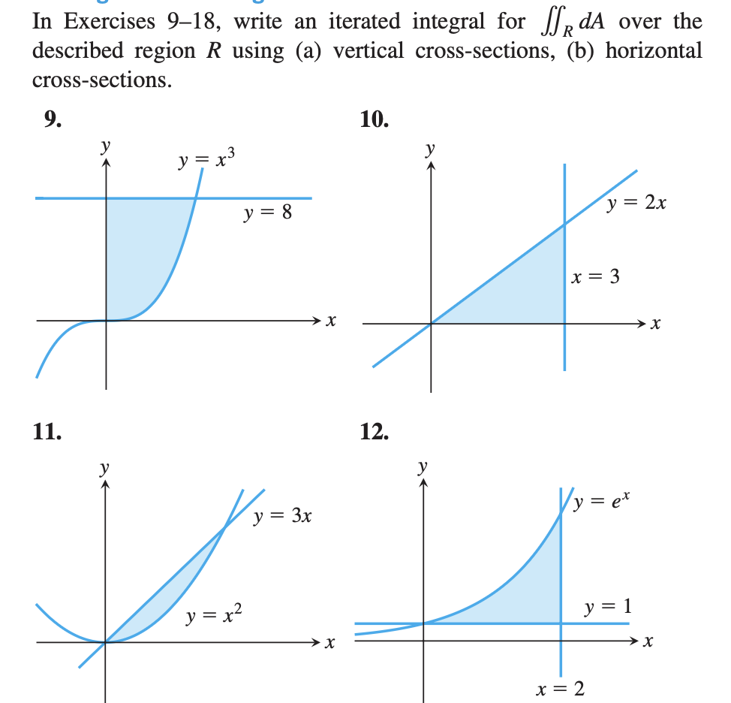

Slide 13


Slide 14
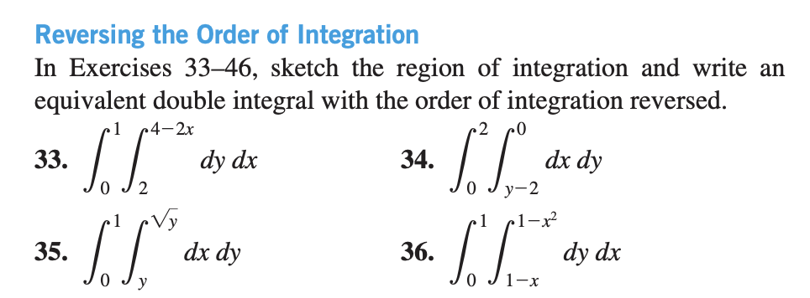

Slide 15
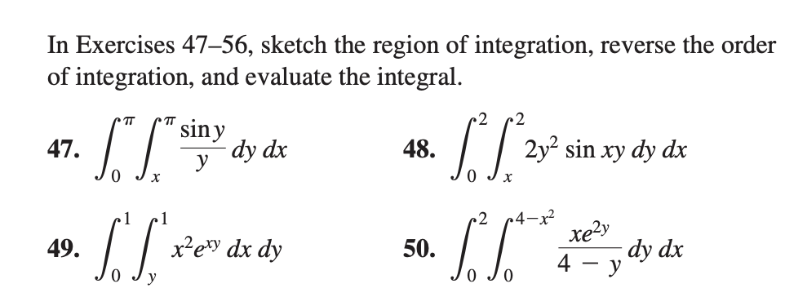

Slide 16
Link to submit assignment
Assignment 2 – Fill in form

